Slide 1
Basics of Networking
By
Shubham Gupta
shubham@vigyantram.com

Slide 2
What are we talking about
When all the connected devices can share the resources such as Data to each other that is networking

Slide 3
What is Internet
Vast network that connects computers/mobiles all over the world.

Slide 4
What is Intranet
An intranet is a computer network for sharing information, computing services within the organization.
Outsiders are not allowed to use it.

Slide 5
What is Extranet
An extranet is an organization’s private network and its available only for selected users.
It’s a way to connect to third parties like vendors, customers, etc.

Slide 6
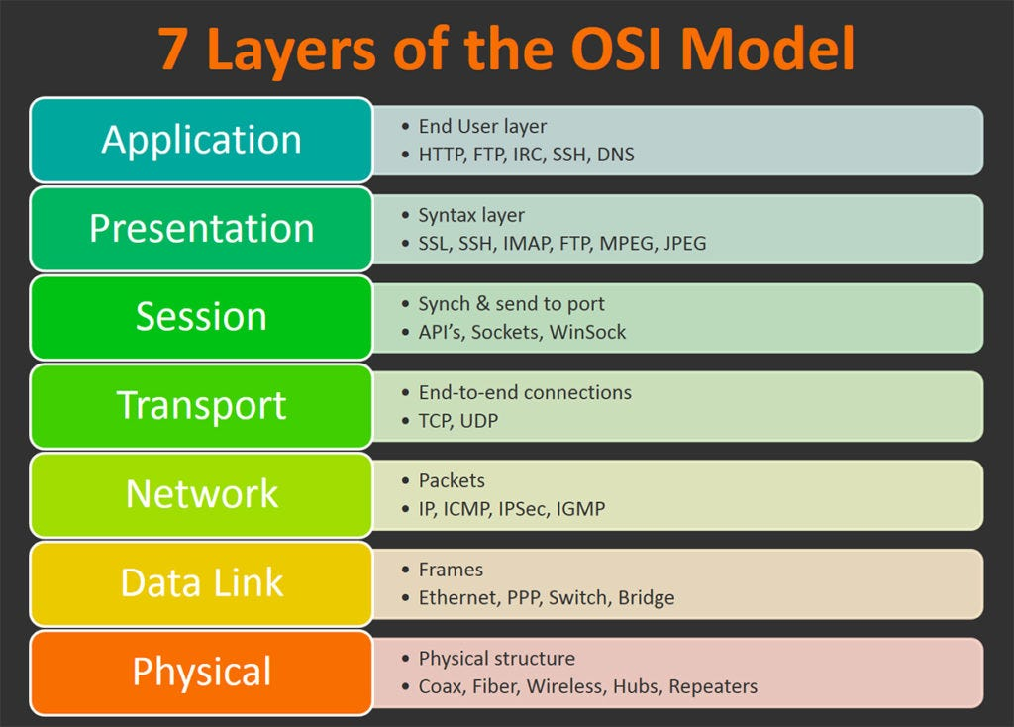

Slide 7
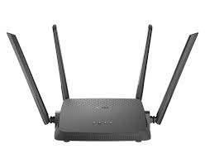
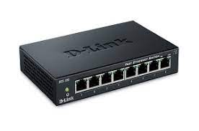
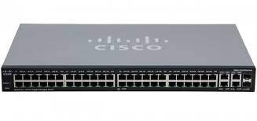
Network Devices
Router
Hub
Switch

Slide 8
Router
A device that connects two or more packet-switched networks or subnetworks.
Two Primary Functions
Managing traffic
Allowing multiple devices to use the same connection.

Slide 9
Hub
A Hub is a central connecting device in a star topology LAN configuration.
Passive hubs are just connecting devices that add nothing to the data passing through them.
Active hubs, also called "multiport repeaters", regenerate the data bits in order to maintain a strong signal.
Share the available bandwidth.

Slide 10
Switch
It is a networking devices use to connect P.C. it is an advance of HUB, because it regenerate the data to destination

